Slide 1
SODAR Device
Yohannes Teclemariam (EE)
Josiah Eleazar Ebreo (EE)
Lorenzo Chen (EE)
Abraham Nkum (CpE)
Advisor: Professor Kim

Slide 2
Overview
Introduction: What is SODAR?
Background: How is it Used Today?
Objectives
Standards and Constraints
Project Overview
Communication System
Hardware
Interface
Broad Impact
Ethical Consideration and Professional Responsibilities
Actual Design
Problems Encountered
Final Design

Slide 3
Introduction: What is SODAR?
● Sound Detection and Ranging
● It is a type of acoustic location that makes it possible to measure different profiles with the help of sound. It works in the same way as a radar system but sends out sound waves, instead of radio signals, for detection.
● Most similar to sonar, except the medium at which the sound waves travel is through air, not water.
● Sends out sound waves and then determining an object’s location through the sound wave that is reflected back to the source.

Slide 4
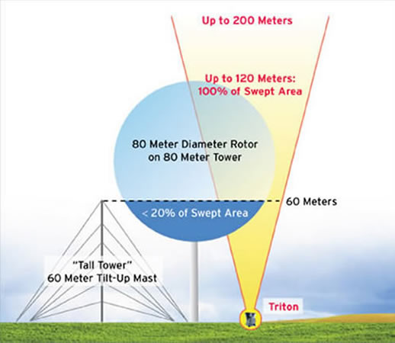
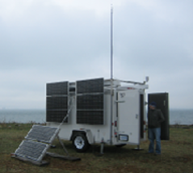
Background: How is it Used Today?
The system is used mainly to measure wind speed at various heights above the ground but also the thermodynamic structure of the atmosphere’s lower layer.
They are designed with a special acoustic horn system with optimised antenna-lobes that measure a three-dimensional wind field with high accuracy.
Figure 1: SODAR compared with other wind speed measurement instruments
Source: Adapted from [1]
Figure 2: UMass Amherst’s “Triton” SODAR
Source: Adapted from [1]

Slide 5
Objectives
● To create a rotating SODAR system that can continuously detect objects.
● To create a UI that displays the location of objects similarly to radar.

Slide 6
Standards and Constraints
Cost
The most expensive parts would be the electrical components, which would be the Arduinos, motor, and transceivers. Thankfully, they are very affordable and cost should not become an troubling limitation for the project.
Scope
The goal of the project is to create a SODAR device that is able to detect and range objects and then output the data onto a User Interface on a computer. We will need to determine the range at which our device is capable of detecting objects as well as being able to make an acceptable UI to view the data. Because this is a low powered device, the range of detection is limited.
Quality
The range of detection is further constrained due to sound waves traveling slower through air than water. Air is less dense than water, so sound waves will be subject to more attenuation[3].

Slide 7
Project Overview
We are going to use two Arduinos that communicate through WiFi for a wireless transmission of data from the spinning platform to the computer for display.
We have to create a platform where the hardware can be implemented on. This includes making a base and attaching a motor to rotate the platform.
Add arduino module with with speaker and microphone.
Create interface that displays objects detected by SODAR.

Slide 8

Hardware
9 volt battery
2 Arduinos with WiFi
Speaker to send sound waves.
Microphone to pick up sound waves.
Platform with rotating top where we can place speaker.
Figure 3: Arduino Uno
Source: Adapted from [2]

Slide 9
Communication system
We are going to use Arduino through wifi. Essentially we will have 2 Arduino. One connected to the Sensor and one connected to the computer

Slide 10
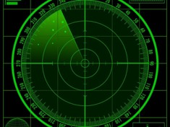
Interface
We will receive the values for the angle and the distance measured by the sensor from the Arduino Board into the code.These variable will be used for drawing the radar, the lines and the detected objects
Figure 5: HC-12 Transceiver/Arduino Circuit
Source: Adapted from [4]

Slide 11
Broad Impact
Since we have repurposed our SODAR device to find objects in the atmosphere the main global impact we have intended for our device is in military defense technology. The global impact it would have is creating a sense of safety amongst nations because they know they would have the ability to detect if their airspaces have unauthorized objects in it.
A major economic impact found were the effects of radio frequency electromagnetic radiation on flora and fauna. For example, the reported global reduction in bees and other insects is plausibly linked to the increased radio frequency electromagnetic radiation in the environment.

Slide 12
Ethical Considerations and Professional Responsibilities
An ethical dilemma can be produced by our SODAR device. Radar devices tend to work better in defense applications but have negative environmental impact and possible economic impact. We must decide whether the radar’s superior performance is worth the environmental and economic problems it could potentially cause due to the radar’s electromagnetic pollution. More research has to be done about the long-term effects of electromagnetic pollution and specifically how much all the radar in commission today contributes to and the effects of those levels.

Slide 13
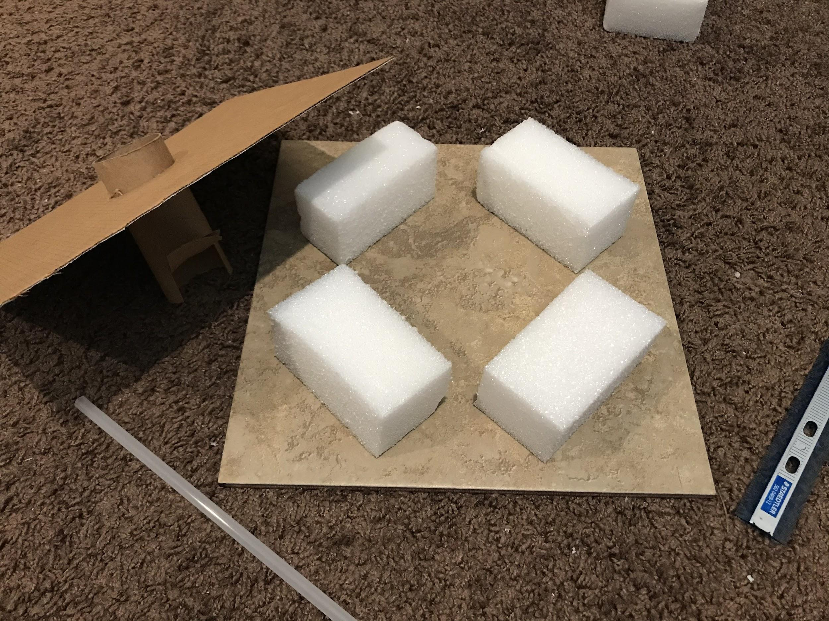
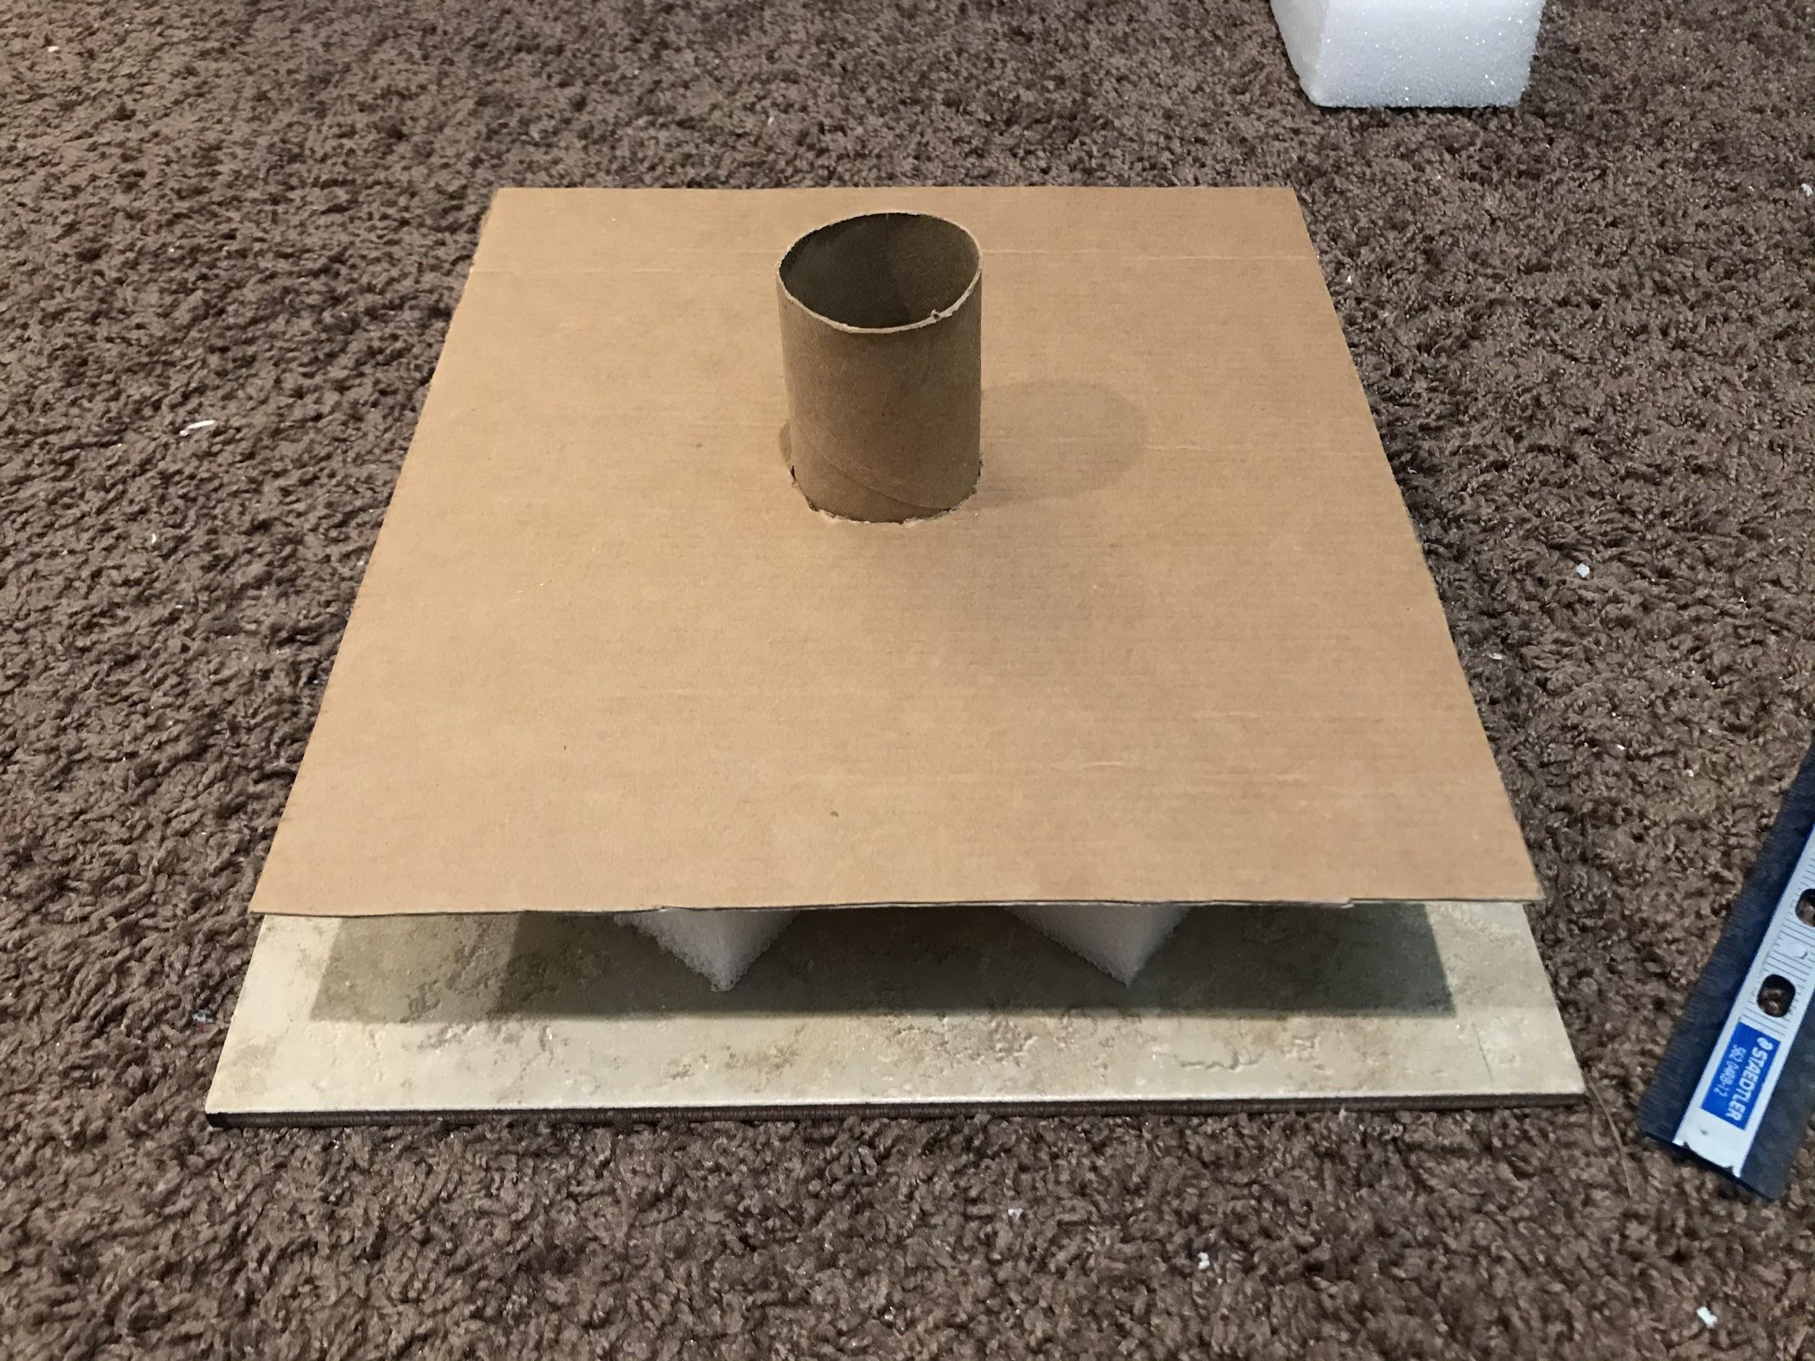
Construction of the base
-Tile base
-Foam blocks stabilize second platform
-Outer tube to house motor and inner tube that motor would spin
Actual Design

Slide 14
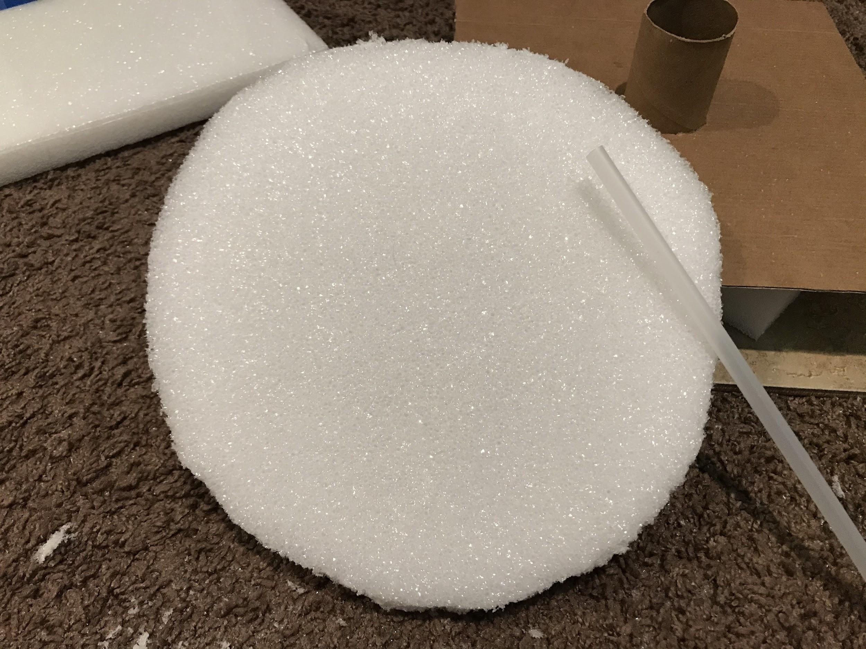
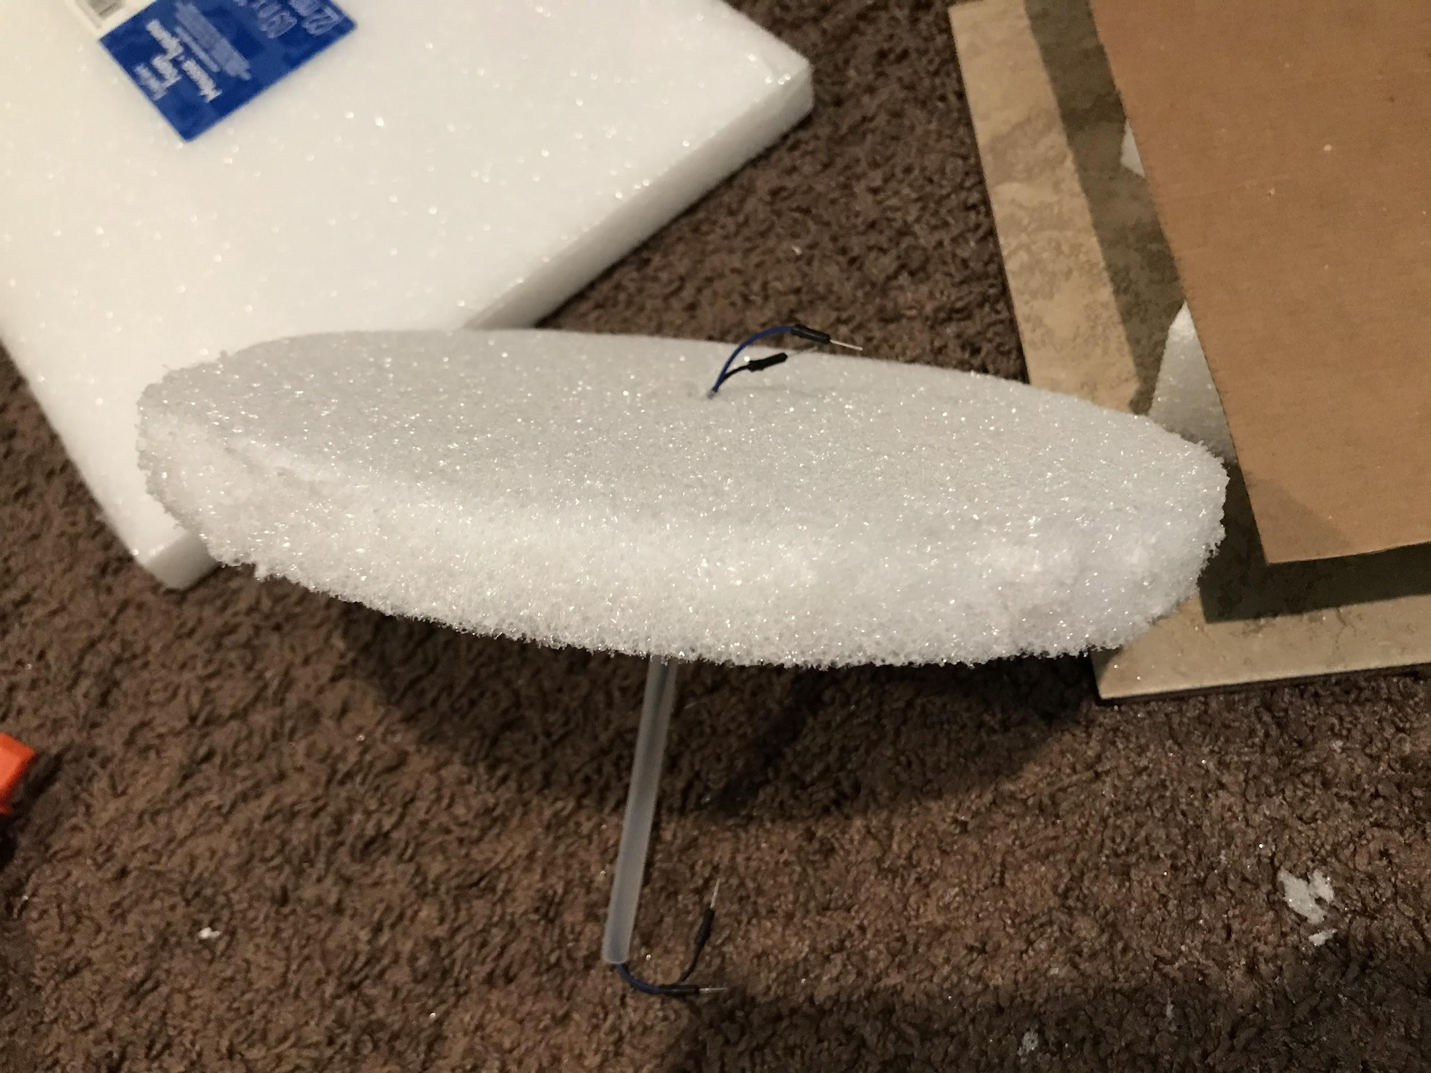
Actual Design
Construction of rotating platform
-Foam cylindrical platform with plastic tube

Slide 15
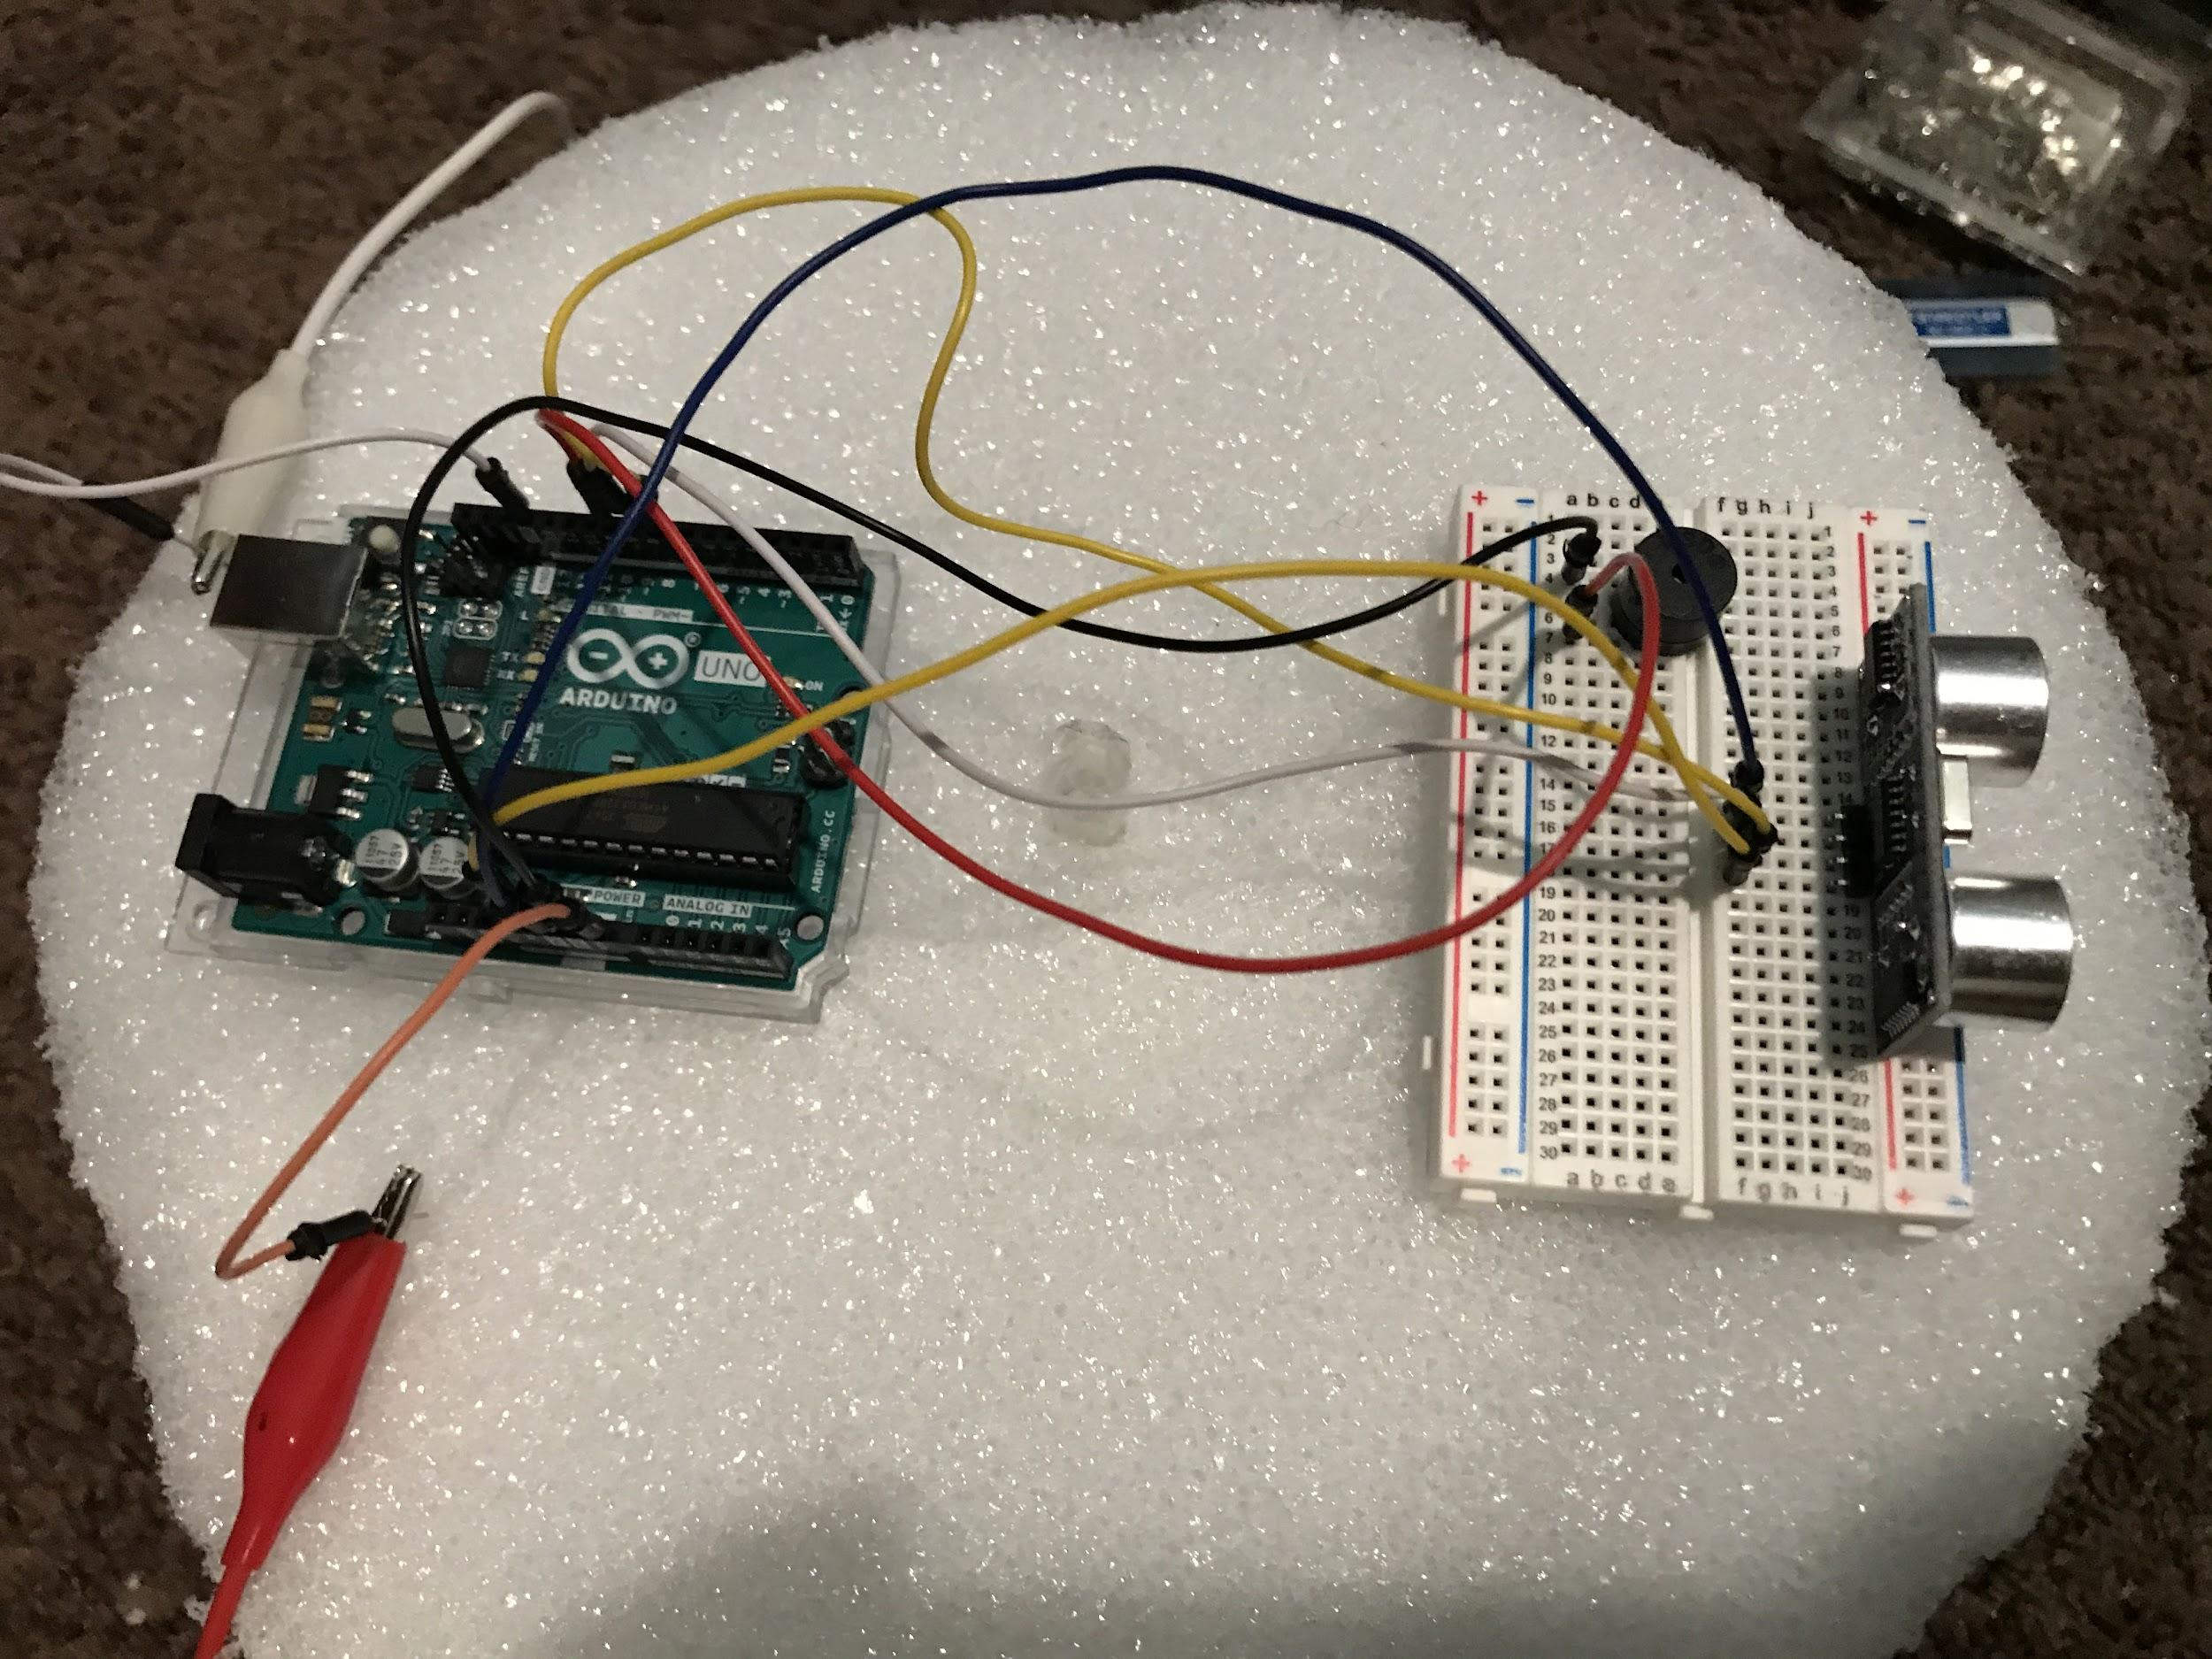
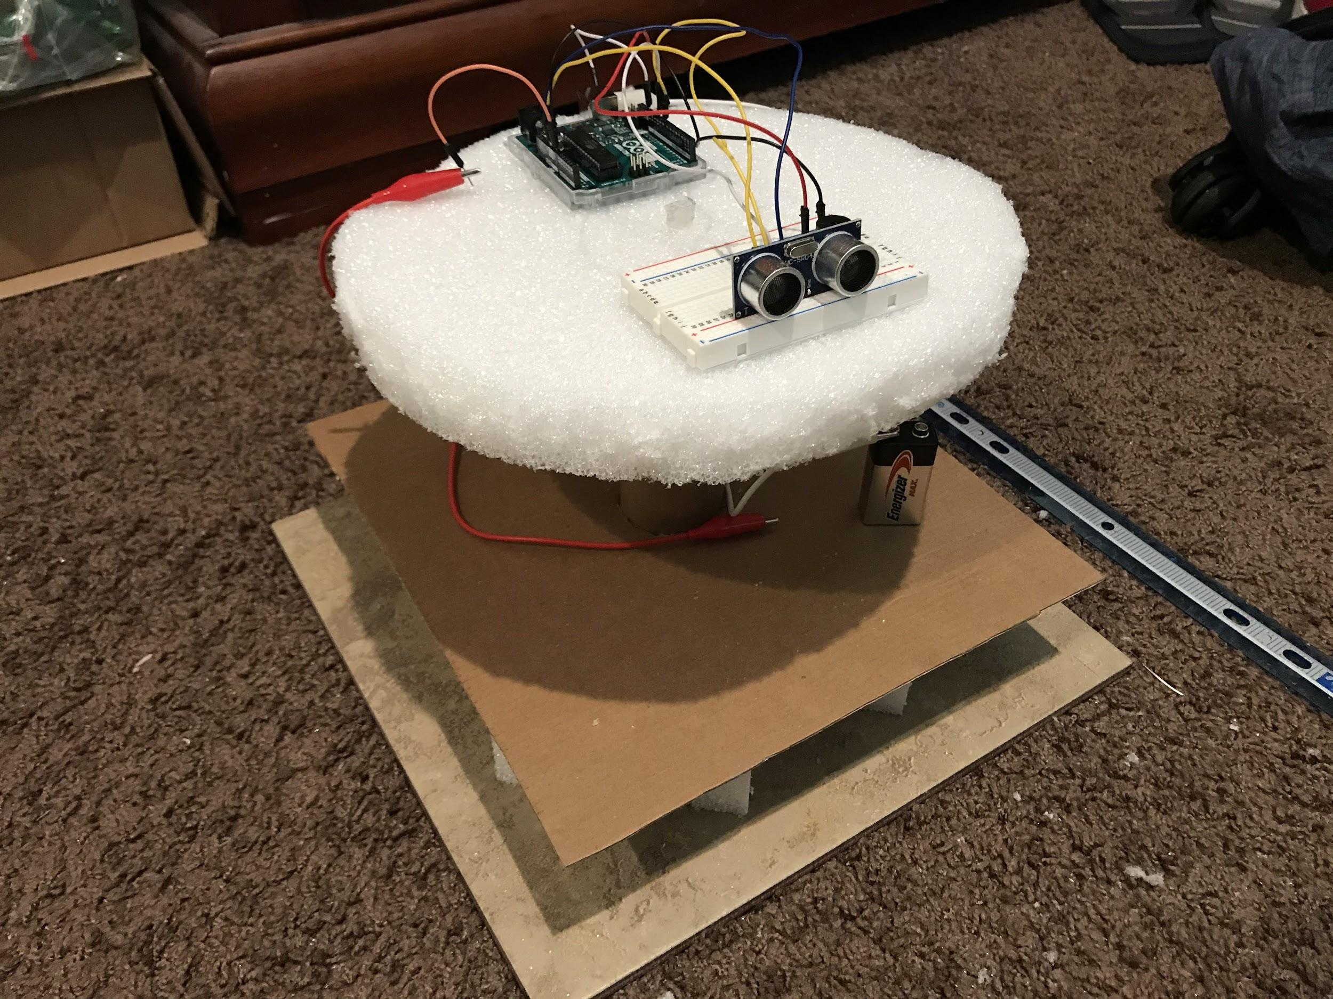
Actual Design
Circuit Wiring and Final Design
-Arduino wired to HC-SR04 ultrasonic sensor and active buzzer
-Powered by 9V battery on second level

Slide 16
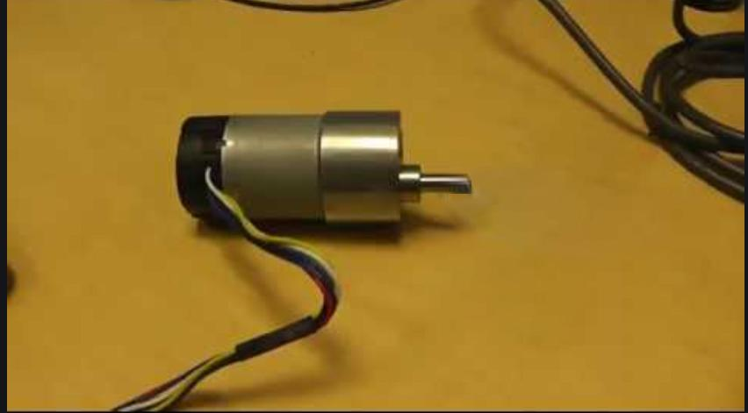
Problems With Design
The motor we were going to use stopped working; we were not able to order a replacement in time due to shipping delays related to COVID-19.
This caused us to not be able to get angular feedback which then prevented us from finishing our UI.
The device still worked as a unidirectional detection device but with manual rotation and feedback through the beeper.

Slide 17

Video Demonstration

Slide 18
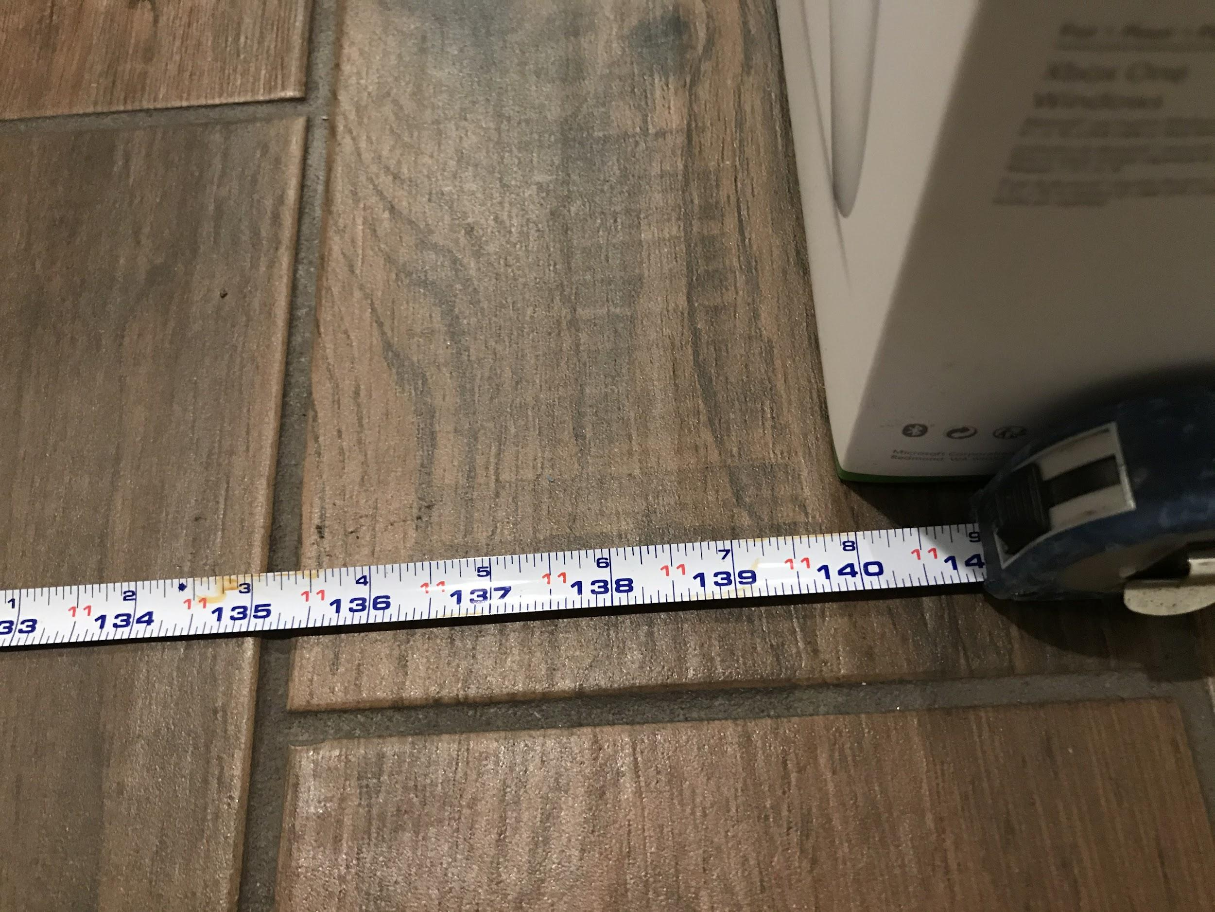
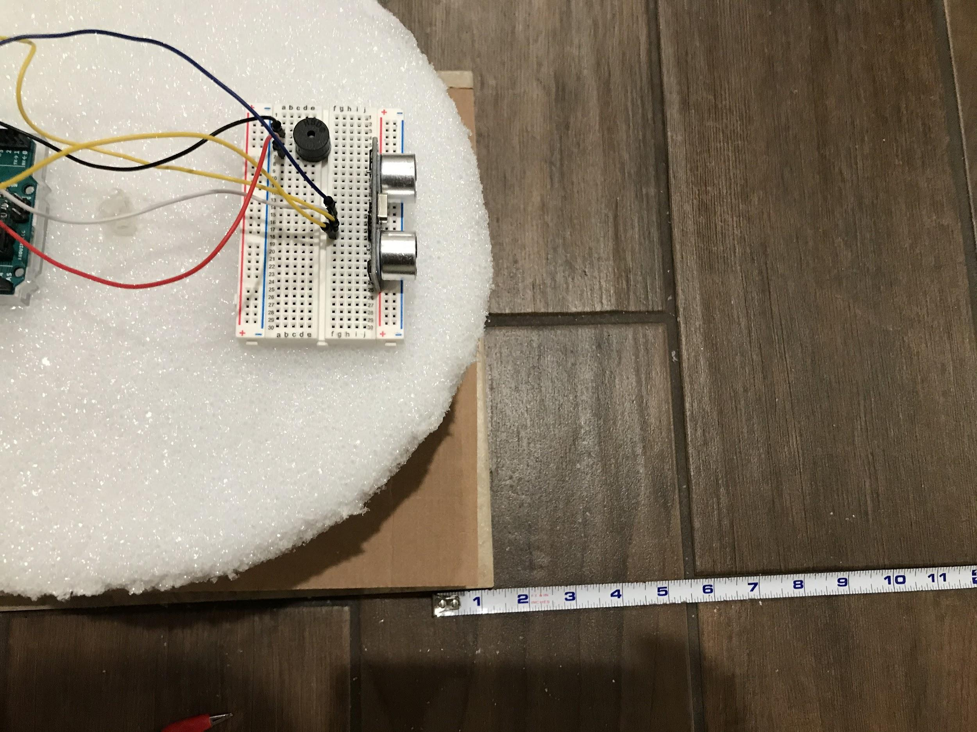
Tested max range: 3.6 meters
Past that range, the device would be inconsistent in detecting the object

Slide 19
References/Bibliography
●[1] University of Massachusetts Amherst, SODAR. [Online]. Available: https://www.umass.edu/windenergy/research/topics/tools/hardware/sodar. [Accessed: Oct - 2019]
● [2] Lady Ada, Arduino UNO FAQ. 2013 [Online]. Available: https://learn.adafruit.com/arduino-tips-tricks-and-techniques. [Accessed: Oct - 2019]
●[3] John WD Hughes, How Quickly Does Sound Attenuate in Water?. 2014 [Online]. Available: https://thenorwoodresource.org.au/article/how-quickly-does-sound-attenuate-in-water/. [Accessed: Oct – 2019]
●[4] Mark Hughes, Understanding and Implementing the HC-12 Wireless Transceiver Module. 2016 [Online]. Available: https://www.allaboutcircuits.com/projects/understanding-and-implementing-the-hc-12-wireless-transceiver-module/. [Accessed: Oct – 2019]
●[5] Arduino-based Ultrasonic Radar System via IOT. 2017 [Online]. Available: https://duino4projects.com/arduino-based-ultrasonic-radar-system-via-iot/ [Accessed: Oct – 2019]

